Slide 1
Understanding species richness and rarefaction across scales
Proposal project BIOL709b
Elske Tielens

Slide 2
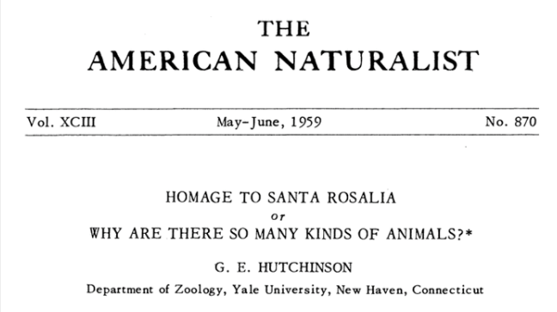

Slide 3
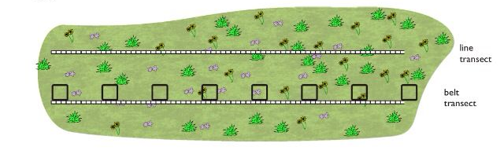
From: Pinterest, user The Educationist

Slide 4
Sampling is not complete
Spatial autocorrelation
Nonlinear richness to sampling curve
From: Pinterest, user The Educationist
Notes:
Of course, your little quadrat doesn’t capture all the species in the entire area
The richness to sampling curve is non linear- and so you can’t extrapolate based on how much you sampled what the richness in a larger sampling area would be
The organisms in your samples are not sampled independent of one another, and there are spatial effects of clumping or aggregation of individuals present in your collection.

Slide 5
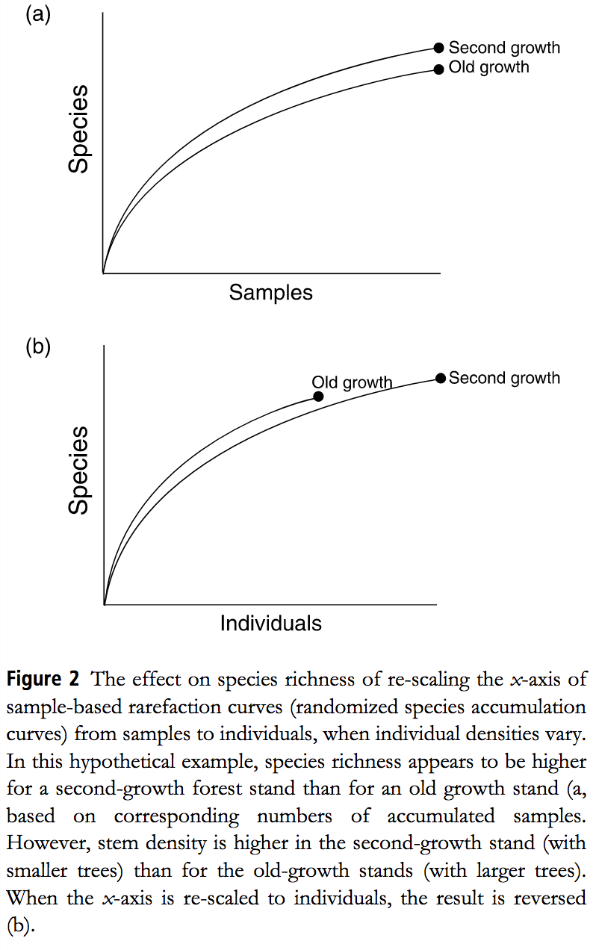
Solution:
Gotelli & Colwell, Ecology Letters 2001
Notes:
But only rarely do we actually sample until the entire curve has assymptoted.
The solution for this is a rarefaction curve:
But results may differ depending on how you rarefy
Standardizing data sets by area or sampling effort may produce very different results compared to standardizing by number of individuals collected, and it is not always clear which measure of diversity is more appropriate. Asymptotic richness estimators provide lower-bound estimates for taxon-rich groups such as tropical arthropods, in which observed richness rarely reaches an asymptote, despite intensive sampling.

Slide 6
Gotelli & Colwell, Ecology Letters 2001
Notes:
If two
samples differ in species density, is it because of
differences in underlying species richness, differ-
ences in abundance, or some combination of both?

Slide 7
Observed richness is driven by:
Regional richness
Number of individuals
Evenness distribution
Aggregation of conspecifics
Gotelli & Colwell, Ecology Letters 2001
Notes:
An assumption for the construction of these rarefaction curves is that spatial distribution of species is random, which it rarely is in reality.
Numbers of individuals (i.e., density effects) The distribution of rarity and commonness (i.e., the SAD) The spatial patchiness or aggregation of conspecifics.

Slide 8
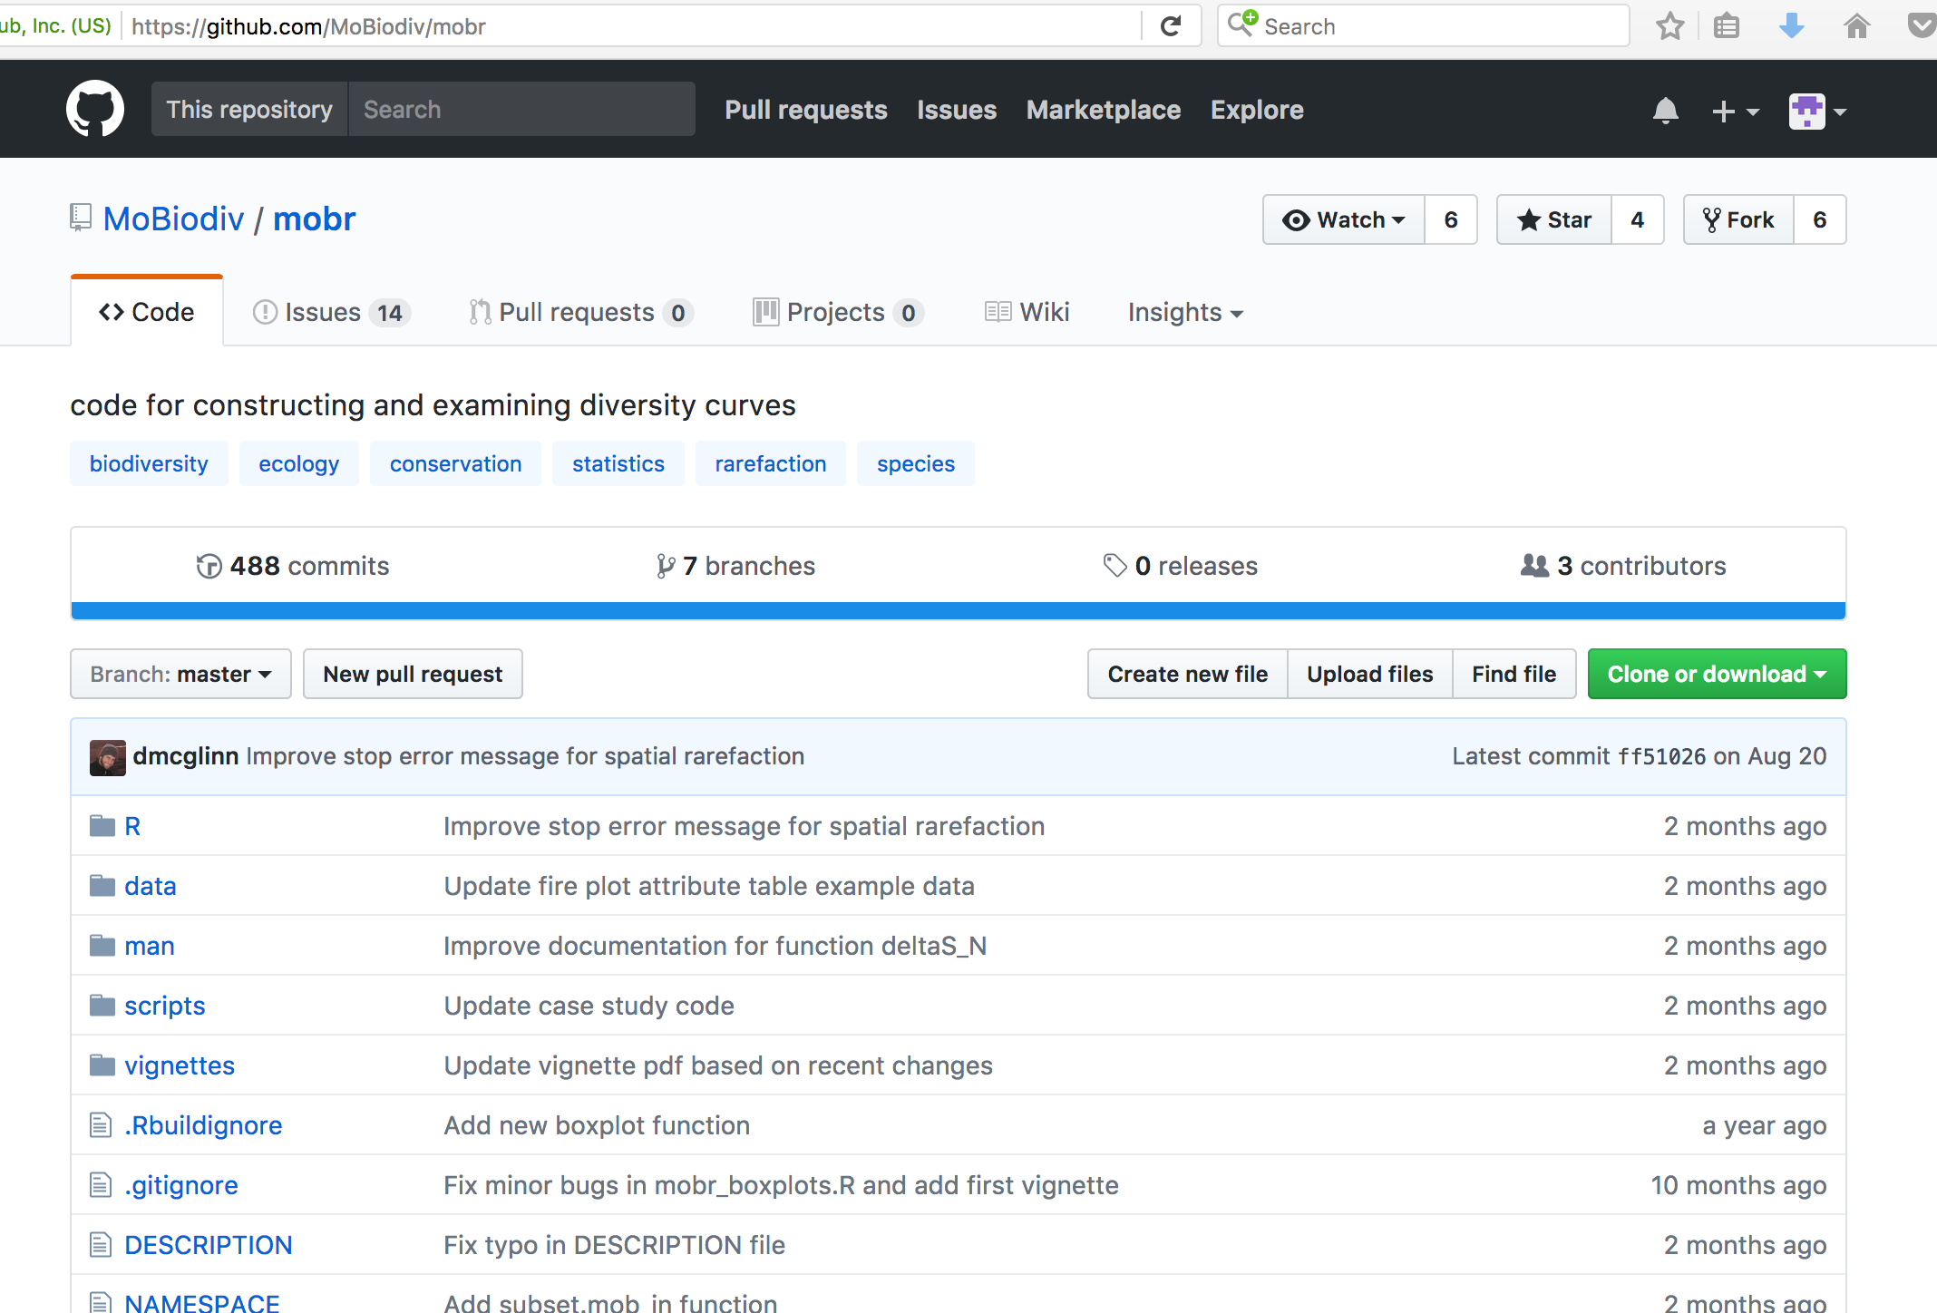
Developers:
Dan McGlinn
Felix May
Xiao Xiao

Slide 9

Point and click >> true function going ons are hidden
My aim is to bring forward the code behind the package, apply to my data, and annotate to be able to find problems
Notes:
Creators of the package aimed to make it as close to click and point as possible
Because so much happens backstage, and it’s a new package, this means that when you have a problem it’s almost impossible to troubleshoot
My aim is to bring forward the code behind the package, apply to my data, and annotate to be able to find problems

Slide 10
Workflow:
Get data in the right format
Run data examples in
mobr package
Exploratory plotting:
Calculate richness, SAD
Create spatial, nonspatial
and individual rarefaction curve
Extract functions from mobr package
Annotate mobr functions to
produce ‘dummy-proof’ code
Calculate rarefied richness difference between treatments across samples/individuals
Plot these values against sample n
Create code for some similar functions (annotated function can be cheat sheet)
Calculate difference between
spatial, nonspatial and
individual rarefaction
Interpret results
Notes:
Of course when I code similar functions, I will omit creating the side code that helps it troubleshoot and assume you do this with data that it works with.
However, individuals are almost never randomly distributed in space, either due to heterogeneity of environmental factors or non-random dispersal of individuals. Thus, it is necessary to develop rarefaction methods that account for such non-random distributions.

Slide 12
